Slide 1
ABC Call Volume Trend Analysis
By : Sarfaraz Ahmed Mulla

Slide 2
Project description
In this project, provided with a dataset that spans 23 days and includes various details such as the agent's name and ID, the queue time (how long a customer had to wait before connecting with an agent), the time of the call, the duration of the call, and the call status (whether it was abandoned, answered, or transferred).Current abandon rate is 40% plan a man force to reduce the abandon rate from 40% to 10% .

Slide 3
Approach
Data understanding
Analysis
Insights
Results

Slide 4


Tech stack used
Microsoft excel 2016
For data analysis and insight collection.
Microsoft PowerPoint 2016
For making report.

Slide 5
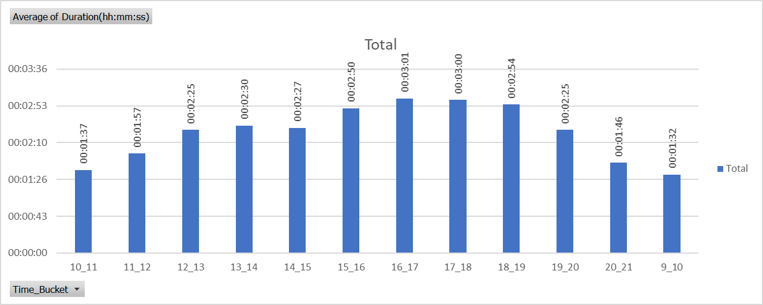
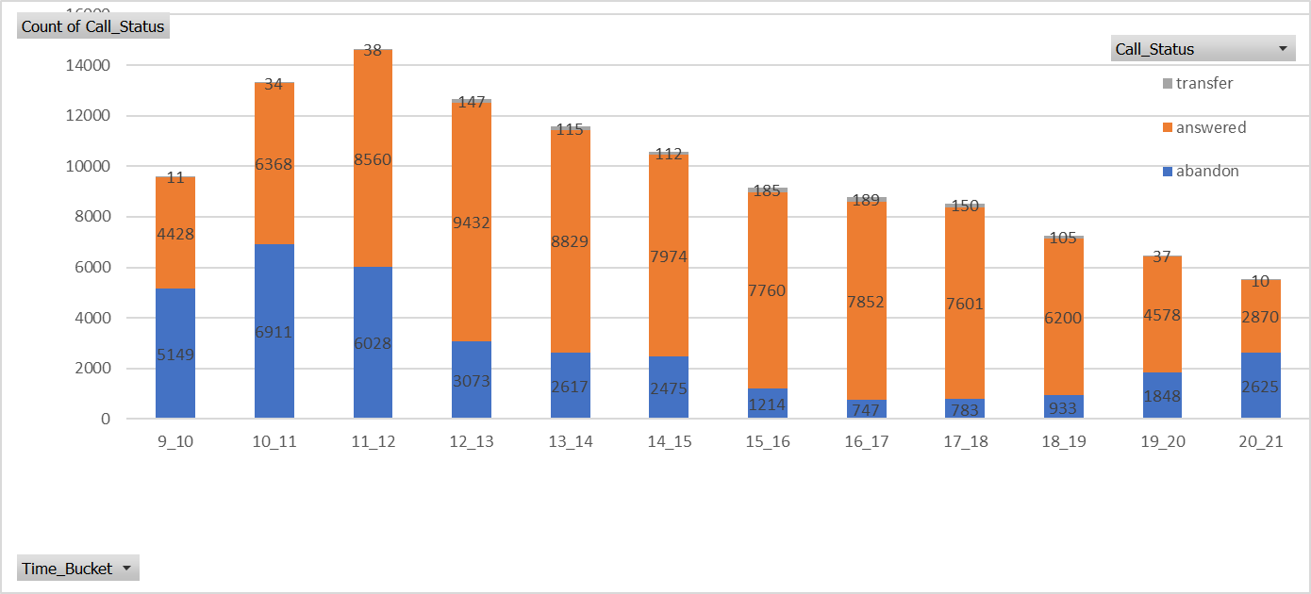
Insights Results
1. Average Call Duration:
What is the average duration of calls for each time bucket?
Using the pivot table select columns time bucket and average of duration is calculated and graph is plotted.
2. Call Volume Analysis:
Can you create a chart or graph that shows the number of calls received in each time bucket?
Using the pivot table select columns time bucket and count call status to count the number of calls and graph is plotted for number of abandoned calls , answered calls , transferred calls .

Slide 6
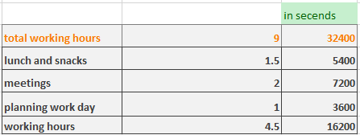

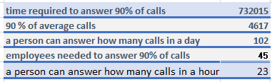

3. Manpower Planning: What is the minimum number of agents required in each time bucket to reduce the abandon rate to 10%?
For calculations I have used average of all the calculations
Calculated total working hours of an employee?
4.5 hours – 16200 seconds
2. Calculated average of calls(23 days )?
5130 calls
Abandoned calls - 1496
Answered calls - 3585
Transferred calls - 49
3. Calculated 90% of average calls?
5130/100*90 = 4617 calls
4. Calculated a person how many calls in a day ?
working hours of employee
average call time = 102
5. Calculated how many calls in a hours ?
calls in a day .
total working hours = 23
6. Calculated how many employees needed ?
90% of average calls .
person how many calls in a day
= 45

Slide 7
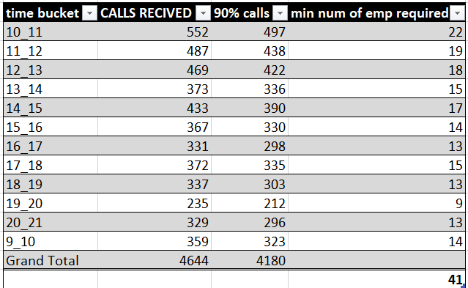
RESULT
Man power planning for day shift
Minimum number of employees required in each bucket

Slide 8
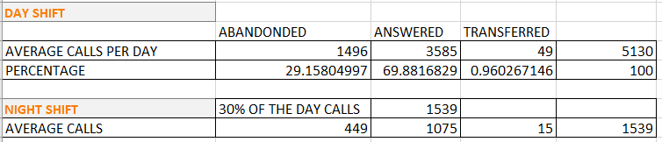
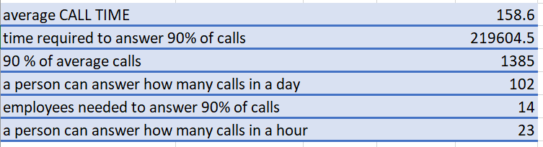
Night Shift Manpower Planning: Propose a manpower plan for each time bucket throughout the day, keeping the maximum abandon rate at 10%.
For calculations I have used average of all the calculations
Calculated total working hours of an employee?
4.5 hours – 16200 seconds
2. Calculated night calls average of calls(23 days )?
1539 calls
Abandoned calls - 449
Answered calls - 1075
Transferred calls - 15
3. Calculated 90% of average calls?
1539/100*90 = 1385 calls
4. Calculated a person how many calls in a day ?
working hours of employee
average call time = 102
5. Calculated how many calls in a hours ?
calls in a day .
total working hours = 23
6. Calculated how many employees needed ?
90% of average calls .
person how many calls in a day = 23
Night calls are 30% of day calls

Slide 9
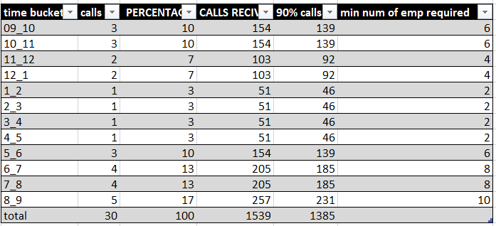
RESULT
Man power planning for Night shift
Minimum number of employees required in each bucket

Slide 10
Hyper link to analysis
https://docs.google.com/spreadsheets/d/19cXaYOcAOuN2_IE1GyrD2W3SiLug_Djc/edit?usp=sharing&ouid=112349825885166255529&rtpof=true&sd=true

